Slide 1
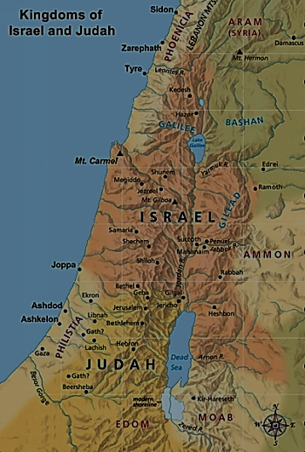
Acts 1:12
Mount of Olives
Jesus’ ascends from this mountain
He will descend on this mountain at the end of history when he returns at his Second Coming (Zech. 14).

Slide 2
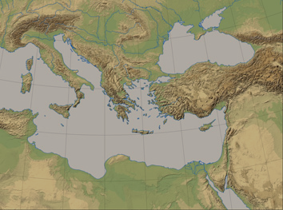
Acts 2:8
Rome
Asia
Phrygia
Pontus
Pamphylia
Cappadocia
Mesopotamia
Crete
Parthian Empire
Cyrene
Jerusalem
Media
Libya
Elam
Egypt

Slide 3
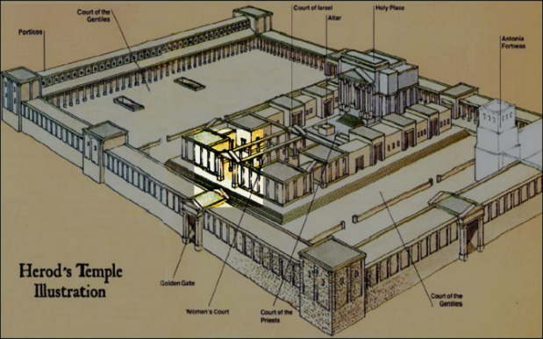
Acts 3:1
Gate Beautiful
Solomon’s portico
Solomon’s portico
Eastern gate of the Temple

Slide 4
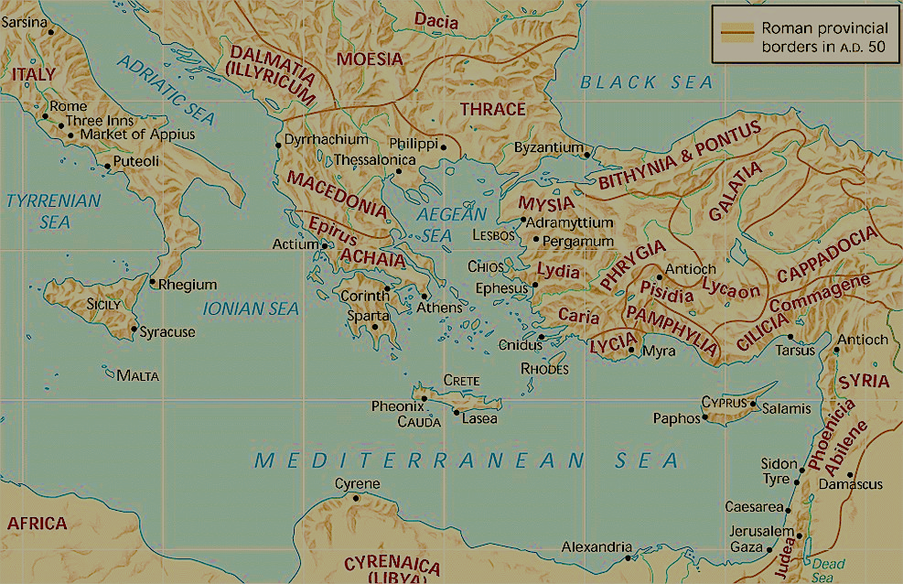
Acts 4:36
Barnabas sold his beachfront property in Cyprus (Acts 4:36-37)

Slide 5
Acts 8:1
Because of persecution, the gospel spreads

Slide 6
Acts 8:14
Apostles send a delegation to Samaria

Slide 7
Acts 8:26
An angel leads Philip down a “desert road” to Gaza to meet the Ethiopian Eunuch

Slide 8
Acts 8:40
The Holy Spirit snatches Philip from Gaza to Azotus
Azotus

Slide 9
Acts 9
Caesarea
Saul (Paul) goes to Damascus to stop Christianity…
Christ goes to Damascus to stop Saul (Paul)
Saul (Paul) comes to Jerusalem after 3 years (Acts 9:26; Gal. 1:18).

Slide 10
Acts 10
Cornelius
Caesarea

Slide 11
Acts 11
Cornelius
Caesarea
Peter goes back to Jerusalem to explain what happened in Caesarea

Slide 12
Acts 12
Caesarea
Herod travels back to Caesarea, gets worshipped as a god, and drops dead
Herod Agrippa I executes James, and he imprisons Peter (~AD 44)

Slide 13
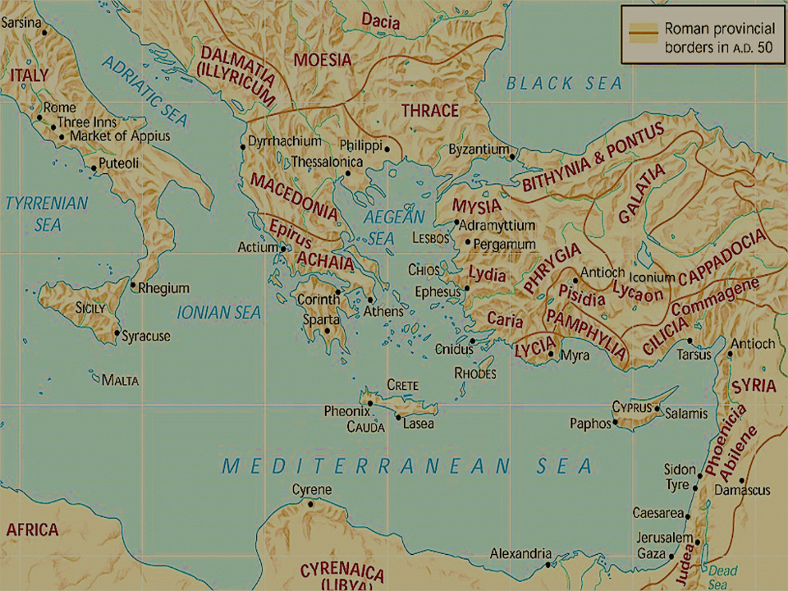
Acts 13
John Mark flakes out and goes back to Jerusalem (v.13)

Slide 14
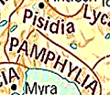
Acts 14:24

Slide 15
Acts 15:36-41
Paul and Silas travel where he had “proclaimed the word of the Lord” (v.36).
Note: on their first missionary tour, they didn’t go through Cilicia. These must have been churches Paul planted in his “lost years” (Gal. 1:21).
Paul wasn’t twiddling his thumbs during this time; he was witnessing (Acts 9:22), making disciples (Acts 9:25), and planting churches.

Slide 16
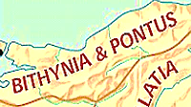
Acts 16
Blocked from going into Bithynia (v.7)
Paul picks up Timothy as a disciple and future coleader (vv.1-3).

Slide 17
Acts 16
“We” passage means Paul picked up Luke in Troas (vv.10-17)
Vision of a man (v.9)

Slide 18
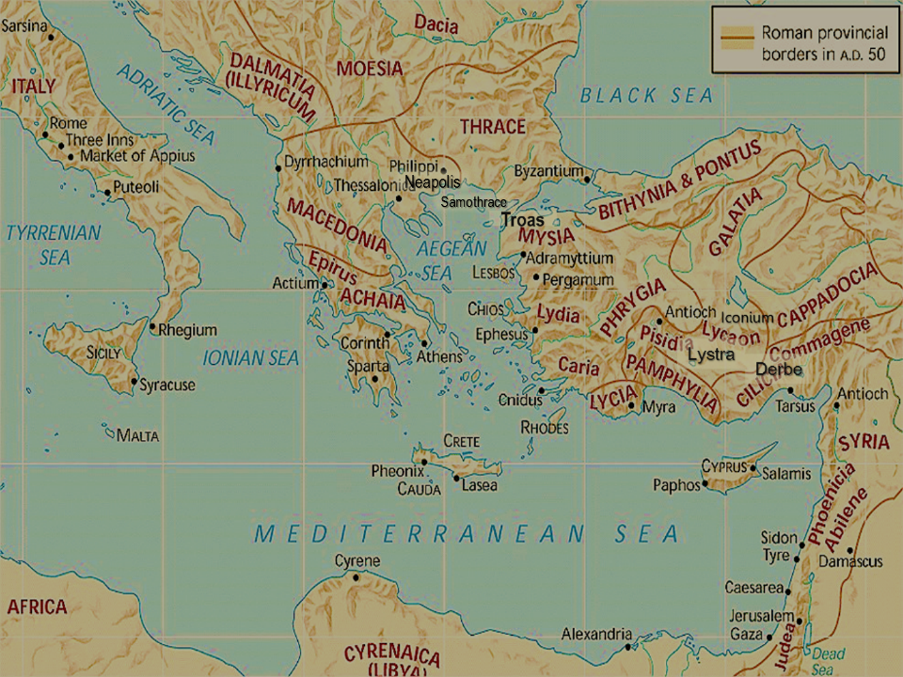
Acts 16:11-40

Slide 19
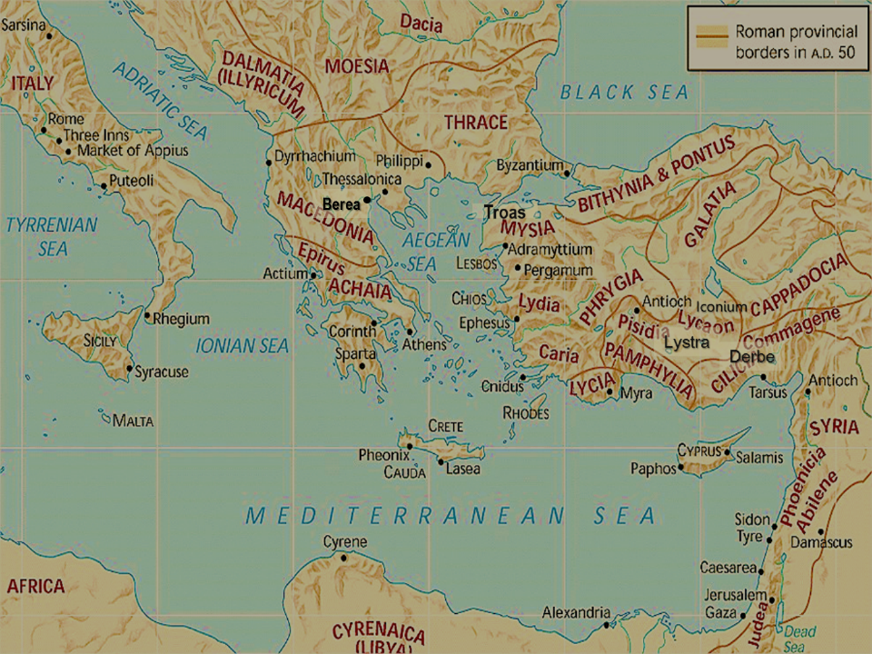
Acts 17

Slide 20
Acts 18

Slide 21
Acts 18:18

Slide 22
Acts 18:24
Apollos preaches in Corinth and Achaia

Slide 23
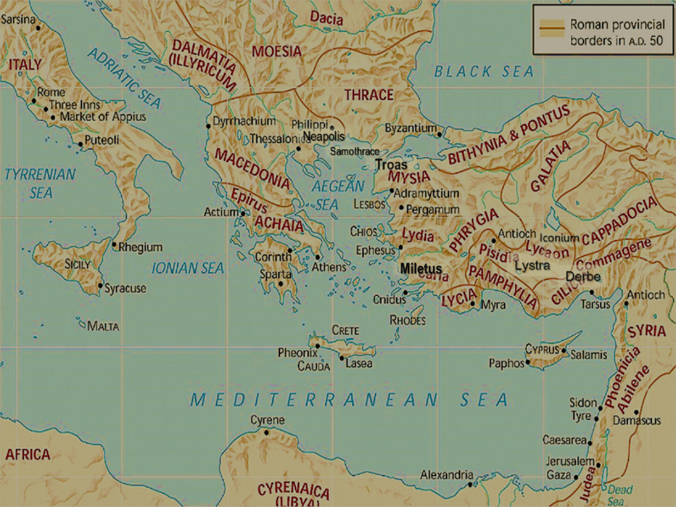
Acts 20
“We passage” means Paul picked up Luke in Philippi (v.5).
Ephesian elders meet up with Paul for one final teaching and to say “goodbye”
Paul spends “three months” in Greece and probably writes Romans (v.3)

Slide 24
Acts 21

Slide 25
Acts 23
The Roman commander transports Paul by night for his own safety

Slide 26
Acts 24
Felix holds Paul here for two years (waiting for a bribe).

Slide 27
Acts 24
Paul shares about Christ with Governor Festus, and it frightens him.

Slide 28
Acts 25
Festus holds Paul here. He invites Agrippa II and Bernice (his sister) to listen to Paul’s testimony.

Slide 29
Acts 26
Paul defends himself before Agrippa II and Bernice

Slide 30
Acts 27
Paul begins his trip to Rome to stand before Caesar

Slide 31
Acts 28

